Slide 1

ALTO Integration and Implementation Supporting CERN Data Management (FTS/Rucio Integration)
Presenters: Jordi Ros Giralt, Mario Lassnig, Mihai Patrascoiu, Y. Richard Yang On behalf of team (Jensen Zhang, Kai Gao, Lauren Delwiche, Mahdi, Ryan Yang)
March 27, 2023
IETF 116
Notes:
https://datatracker.ietf.org/doc/draft-ietf-alto-new-transport/
https://datatracker.ietf.org/doc/draft-schott-alto-new-transport-push/

Slide 2
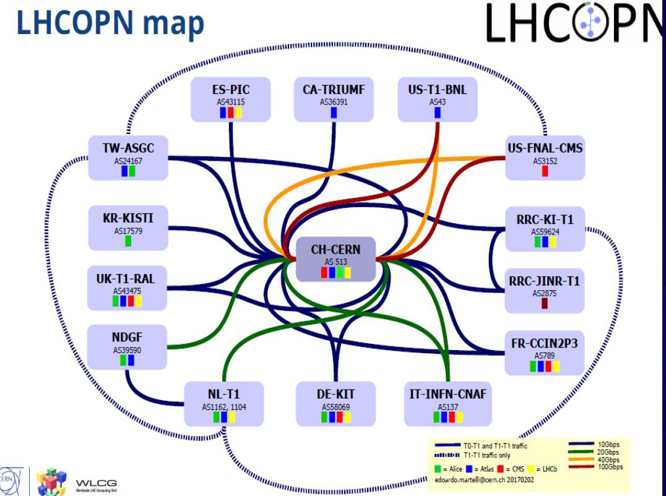

Overview: LHCONE
LHCONE
Part of CERN infrastructure (experimental facilities, LHCOPN, LHCONE)
Topology: 600 distributed storage systems, distributed globally (170 data centers, in 127 sites, across 40 countries)
Workload: support data movement for four LHC experiments, and also Belle II, Pierre Auger Observatory, NOvA, XENON, and JUNO
Traffic: 2022, the aggregated outgoing traffic just from CERN to its ten largest connected data centres: 457 Petabytes of data.

Slide 3
Overview: Related Software Stack
Data-Intensive Workflows
Data Management / Transfer Orchestration (e.g., Rucio)
Our focus
Data Transfer Scheduling (e.g., FTS)
High-level goals:
Efficiency
Fairness
Transfer Data Plane
(e.g., GridFTP, XRootD, HTTP)
Internet Transport Layer (e.g., TCP, TCP/Cubic, BBR)
Networking Layer (e.g., traditional networking, AutoGOLE/SENSE, NOTED, Programmable net)

Slide 4
Outline
Overview
Transport scheduling integration (ALTO/FTS)

Slide 5
Transfer Scheduling (FTS): Objective and Design
Related objectives:
Efficiency control: Avoid overloading transfer resources (both network and storage), fully utilize all capacity
Fairness/allocation: resource allocation beyond congestion
Data-Intensive Workflows
Data Management / Transfer Orchestration (e.g., Rucio)
Transfer Scheduling (e.g., FTS)
Mechanisms:
Keeps transfer queue for each src/dst pair (pipe)
Adjusts # concurrent TCP connections per pipe
Dispatches transfer if allowed by concurrency level
New but not fully integrated mechanisms:
Each file transfer (src->dst) is marked as on behalf of an activity of an experiment
Transfer Data Plane
(e.g., GridFTP, XRootD, HTTP)
Internet Transport Layer (e.g., TCP, TCP/Cubic, BBR)
Networking Layer (e.g., traditional networking, AutoGOLE/SENSE, NOTED, Programmable net)

Slide 6
ALTO/FTS Objective: Application-Defined Networking
Diverse, High Level Resource Models
ALTO/FTS Scheduler
Universally available
Fast, efficient, robust building block
But single resource allocation (fairness) model
Universal, Minimal TCP Congestion Control (TCC)
Diverse Network Settings

Slide 7
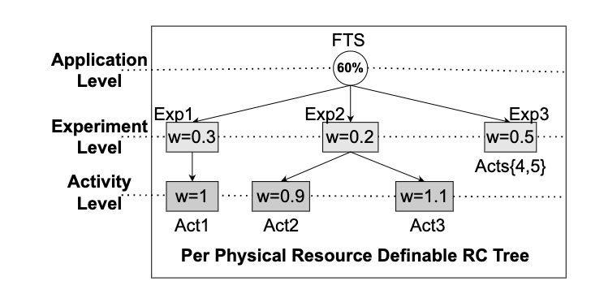
ALTO/FTS Architecture
pipe[i].src
pipe[i].dst
AS 1
AS 2
AS 3
Link 1.1
Link 3.1
project
activity
pipe
Resource Model
Resource use visibility: pipe -> resources
Scheduler: concurrency level, time multiplexing
Trans q1
Trans q2
Trans q2
ALTO/FTS, also called TCN: Light-weight control plane on top of fully distributed TCC

Slide 8
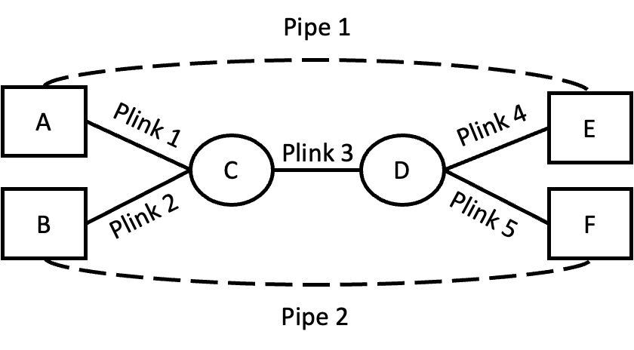
Simplified Example Illustrating ALTO/FTS Visibility, Control
3G
Resource Model:
Project 1 pipes: Pipe 1, Pipe 2
R1: <Project 1, Plink 1> <= 5G
R2: <Project 1, Plink 2> <= 10G
R3: <Project 1, Plink 3> <= 10G
9G
App Provided State:
Pipe1.traffic = 3G, Pipe2.traffic = 9G
Resource use by project on physical resources:
Plink1.traffic = 3G, Plink2.traffic = 9G, Plink3.traffic = Pipe1.traffic + Pipe2.traffic = 12G
ALTO Provided State:
Pipe 1: {Plink 1, Plink 3, Plink 4}. Pipe 2: {Plink 2, Plink 3, Plink 5}.
Penalty for resource control constraints:
P(R1) = 0 (Plink1 = 3G <= 5G) , P(R2) = 0 (Plink2 = 9G <= 10G)
P(R3) = 2 (Plink3 = 12G > 10G)
Notes:
5,10G are absolute bounds.

Slide 9
ALTO/FTS Visibility
IETF ALTO Protocol as Front End
Other Sources
Control Plane
Data Plane Control: FIB
Data Plane Data: Sample
GeoIP
Config->FIB
FIB/DP driven
G2 snapshot
Samples (netflow, sflow)
PerfSonar (ICMP)
Equivalent Class
Looking Glass
P4
<switch interface , pkt attr>
<src, dst, <metric, val>>
adjac
subnets
BGP input

Slide 10
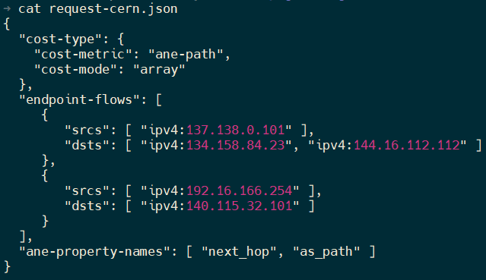
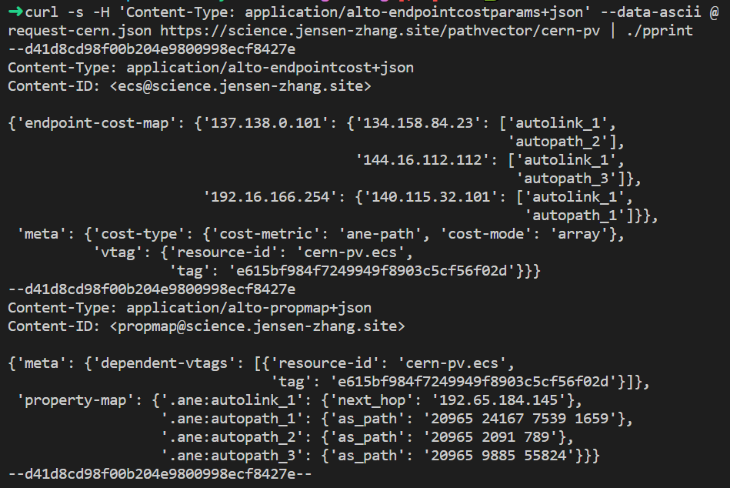
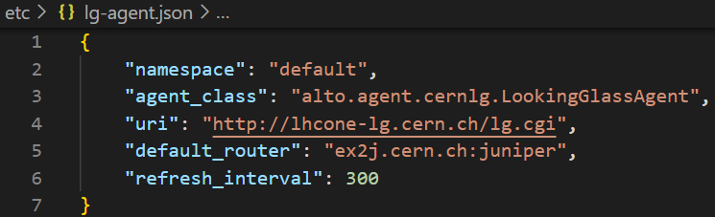
ALTO/FTS First Hop Visibility
Query Example (ECS with path vector extension)
Query/Response
Routing Plane Retrieval (Looking Glass of CERN and GEANT)
Implementation
Jensen/Kai/Lauren

Slide 11
ALTO/FTS Control Implementation
Integration into FTS 3.12
Extend database schema for pipes (t_link_config) to support resource control specification (tcn_abs_limit, tcn_rel_weight)
Implement ALTO/TCNOptimizer class for ALTO/TCN control loop
Implementing ZeroOrder Gradient with Integral, Quadratic Distance function
Add new optimizer mode (kOptimizerAggregated) to enable ALTO/TCN optimizer
Notes:
Transition sentence (at end of previous slide): To fully appreciate how the designs are realized, let’s first build a big picture view of TCN.
(1) create pipes specifying src and dst, as well as resource control requirements: the bounds and rel-weights.
(2) transport select (Rucio) pushes a transfer. Additionally, going beyond FTS, TCN supports ordering constraints
(3) 3 control loops, 3-alto: network resources info, 3-control n, 3-data: when transfer finished, guided by 3-control.
Important points:
1- TCN can aggregate the information among multiple networks using ALTO (One of the complexities given in the
There are three main control loops:
The ALTO execution loop updates the mapping from pipes to the network resources, and uses ALTO to obtain information about network resources . (is this the routing matrix * T matrix multiplication thing)

Slide 12
Outline
Overview
Transport scheduling integration (ALTO/FTS)
Transport orchestration integration (ALTO/Rucio)

Slide 13
ALTO/Rucio Objective: Uniform Orchestration Selection
Rucio Orchestrator
Uniform ALTO Sorting Interface
Diverse Network Visibility Resources

Slide 14
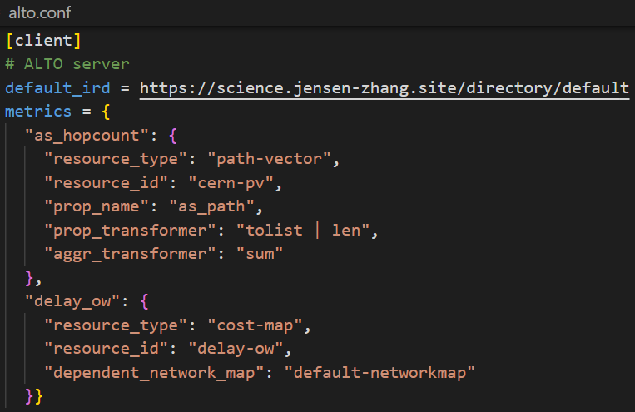
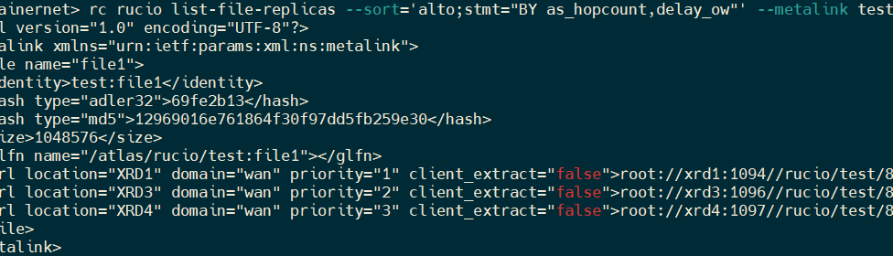
ALTO/Rucio Using Query Expression
Step 1: Configuration
Configure ALTO client at Rucio server to fetch visibility using ALTO
Step 2: Express Sorting using ALTO/Rucio Expression
ALTO sorting expression enables Rucio download command to sort replicas based on a combination of distances and properties, e.g.,
BY=as_hopcount,delay_ow WHERE continent=”EU”
Map properties of ANEs into end-to-end metrics
Jensen/Kai/Lauren

Slide 15
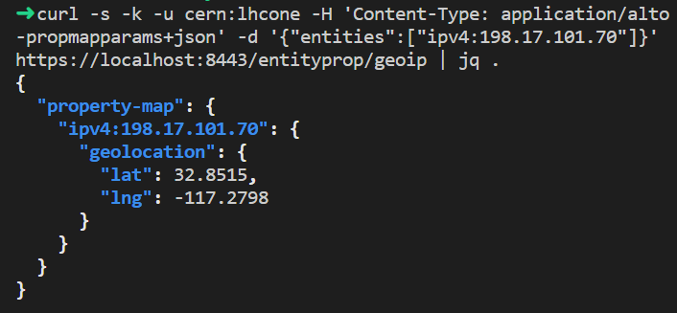
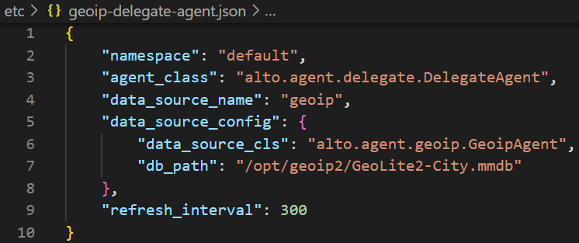
ALTO/Rucio Using Query Expression: Default/Backup GeoIP/Distance
Providing geoip property using the standard ALTO endpoint property service [RFC 9240]
Providing geo distance between endpoints using the standard ALTO Endpoint Cost Service (ECS) [RFC 7285]
Query interface
Implementation Config
Notes:
Wording: Initial, not to change the default Rucio selecting data movement. GeoDistance is a default data movement selection mechanism in Rucio, and we now use alto to provide the standard implementation. Unifying the interface. Use download file; or use Web service

Slide 16
Summary: Current ALTO/FTS+Rucio: 3 Main Components
Data Flow Orchestration (build on Rucio)
Resource Control
Model
Scheduling of Data Movement Tasks (build on FTS Integration)
Visibility of Multidomain Infrastructure (e2e aggregation and select control assets)

Slide 17
Status and Next Steps
Implementations
ALTO/FTS
Visibility: looking glass first-hop links (e.g., CERN border links to peers)
Control: Zero-order stochastic gradient algorithm, event-driven programming
Scale: 200x40, targeting 600x600 full mesh
Resource model: Full linear model
ALTO/Rucio
Fully integrated, uniform interface
Deployment
Target full production workload in summer 2023, for HL-LHC Data Challenge

Slide 18
Backup Slides

Slide 19
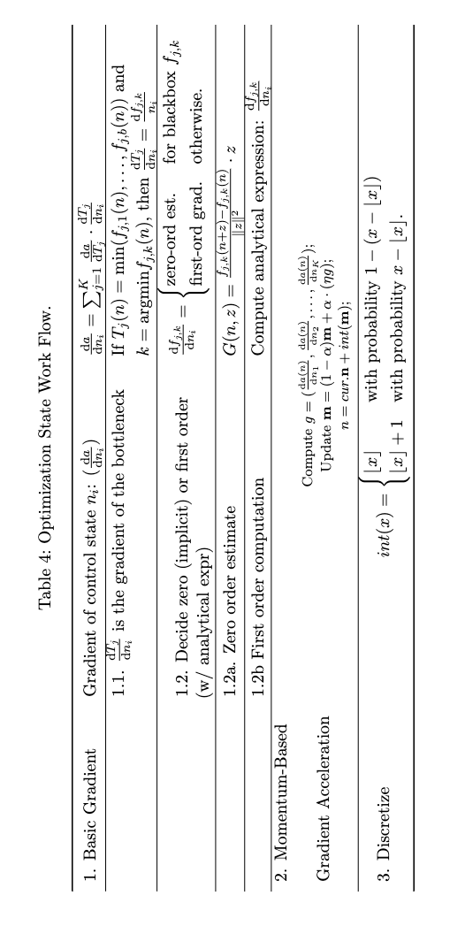
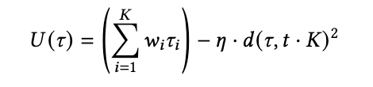
ALTO/FTS Control Details
Integral, quadratic distance function
Zero-order stochastic rounding

Slide 20
Basic ALTO/FTS Benchmarking ⇒ Real Topology (ESnet)
ALTO/TCN FTS
ALTO/TCN FTS
7.39x total BW utilization.
5.54x Max RCT improvement. (Short-tailed)
Global Objective, Zero-order gradients, and Resource Control Constraints.
Setting: 30 <src, dst> pipes, one request per pipe, each request 20K transfers, file size = 100MB. the total in the workload is 60TB.
Resource Control goal: all equal weights
Notes:
Key: Now that we have an understanding, let’s see if these are still true in a real ALTO/TCNology.
30 <src, dst> pipes, each pipe has 20K transfers, each transfer file size is 100MB, for a total 2TB per pipe, the total in the workload is 60TB
Transition: Next, For the system wide measures and static arrival patterns, we moved to a more complicated substrate network (ESnet) with 30 x 2TB transfers. We can see improvements in max BW utilization and Max FCT improvements. Our discussions with the CERN team indicates the importance of max FCT as the practical transmission times distribution of FTS is currently long-tailed.

Slide 21
Basic Benchmarking: Results
ALTO/TCN FTS
ALTO/TCN FTS
 | FTS Semi-Gradient (FTS-SG) | ALTO/TCN FTS
Total BW Utilization | Not optimal (6GB unused BW). | Fully utilized BW.
Resource Control | BW shares not satisfied. | BW allocated close to 2:1 spec.
RCT | Max RCT = 20,000 slots. | Max RCT = 4,000 slots.
FTS-SG depends on correct configuration (e.g., high enough default). ALTO/TCN is fully automated.
Notes:
a <src, dst> pipe (pair), 200K transfers, each transfer file size is 100MB, for a total 20TB
20TB 100MB each 200K transfers
Transition: For the system wide measures and time-slot 0 arrival patterns, we will start with the most simple case to show that FTS controller to show how FTS is superior in terms of adaptation to dynamic BW control conditions (component D) and optimality (components A and B). RHS TCN, LHS FTS.

Slide 22
Request Performance Distribution
2.03x mean RCT improvement.
2.49x max RCT improvement.
Global Objective, Zero-order gradients, and Resource Control Constraints.
ALTO/TCN FTS
Setting: Similar to previous slide, but with modification to include more requests to show more details: 100 <src, dst> pipes, one request per pipe, each request 5K transfers, file size = 100MB.
Resource Control goal: all equal weights.
Notes:
Key: Here, we are looking at individual transfers. This is the cumulative distribution function
100 <src, dst> pipes, each pipe has 5K transfers, each transfer file size is 100MB, for a total 500GB per pipe, the total in the workload is 50TB
Transition: Next we switch to more fine-grained metrics, to show the performance difference between TCN and FTS in terms of single-pipe characteristics. For a large number of flows on the ESnet ALTO/TCNology average flow completion time drops by a large factor if we change from the native FTS to TCN.

Slide 23
From All-Arrival Workload ⇒ Dynamic Arrival Workload
ALTO/TCN
ALTO/TCN
ALTO/TCN
ALTO/TCN
Setting: ESnet (67 nodes), selected 50 active pipes; each pipe has transfer workload arrives according to a arrival distribution (Poisson arrival, with parameter 1200 (every 200 time slot); Each replication request has N(40k, 20k) files, file size is 100MB.
8.0x improvement in RCT when using ALTO/TCN.
(Global Objective, Full Zero Order)
Notes:
In all previous simulations, all transfers arrive at the beginning. Let’s see what happens when they arrive one by one. Each of the 50 bars represents the individual flow completion time of each of the 50 transfers. Compared to FTS, we can see that TCN, in green, has bars 7 times smaller and thus 7 times faster. And this final evaluation shows the benefits of the TCN optimizer.
ESnet (67 nodes), selected 50 active pipes; each pipe has transfer workload arrives according to a arrival distribution (Poisson arrival, with parameter 1200 (every 200 time slot); Each replication request has N(40k, 20k) files, file size is 100MB.
Transition: Next we investigated the case where new transfers dynamically arrive to the system with an exponential time distance (every 200 time slots in average), transfer sizes is normal with an average of 4 TB.

Slide 24
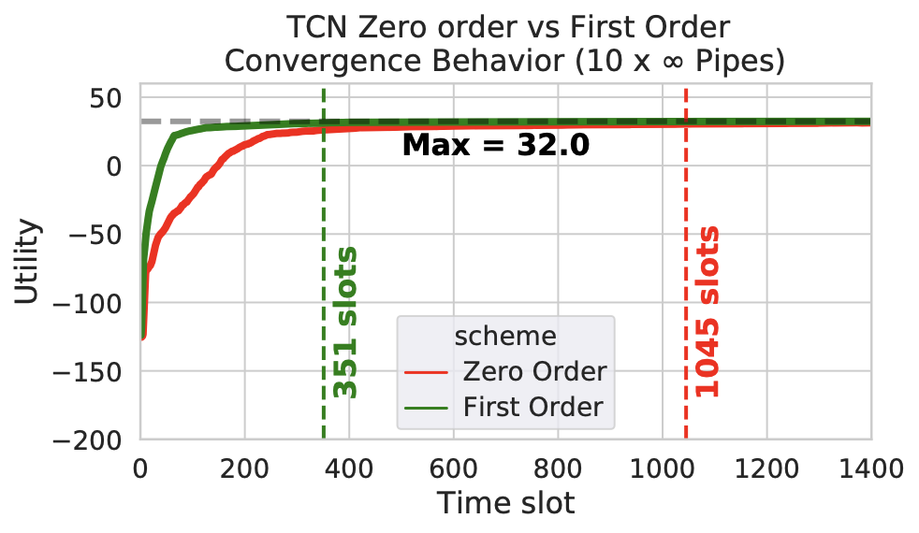
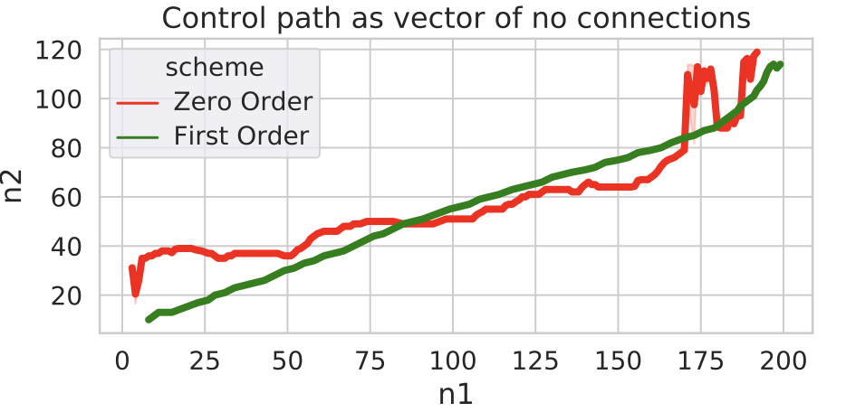
ALTO/TCN Zero-order vs First-order
ALTO/TCN
2.97x improvement in convergence speed (# transient slots) with using first-order gradients.
First-order integrated ALTO/TCN vs Full Zero-order ALTO/TCN
Setting:ALTO/TCNology ESnet, selected 10 pipes, infinite backlog.
Notes:
Red, Zero-Order: squiggly,, First-Order, Green: straight line.
ALTO/TCNology ESnet, selected 10 pipes, infinite backlog
Transition: One of the major novelties of TCN is the component C, using modeled optimization (e.g. bottleneck structure) TCN can accelerate convergence. As shown in the slide component C over B … LHS the path taken by the first two pipes. RHS: convergence speed and state.

Slide 25
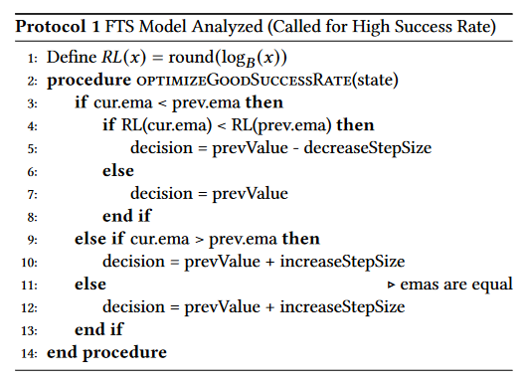
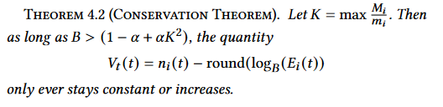
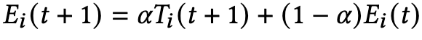
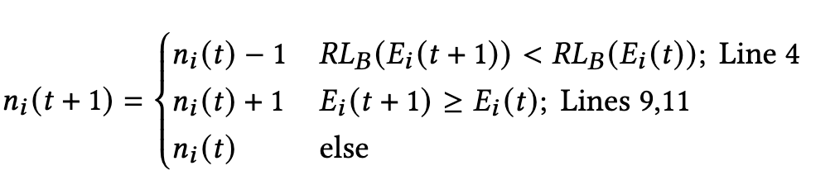
FTS Control Gap
resource flexibility/fairness control gap
A Semi Zero-Order Gradient Alg Optimizing for Each Pipe
Keep track of the exponential moving average (EMA) of throughput.
Update the number of connections based on EMA.
efficiency gap
Theorem: In a Throughput-Deterioration Model, semi zero order will achieve throughput that is <= 1/√B of the optimal (under default settings).

